Slide 1
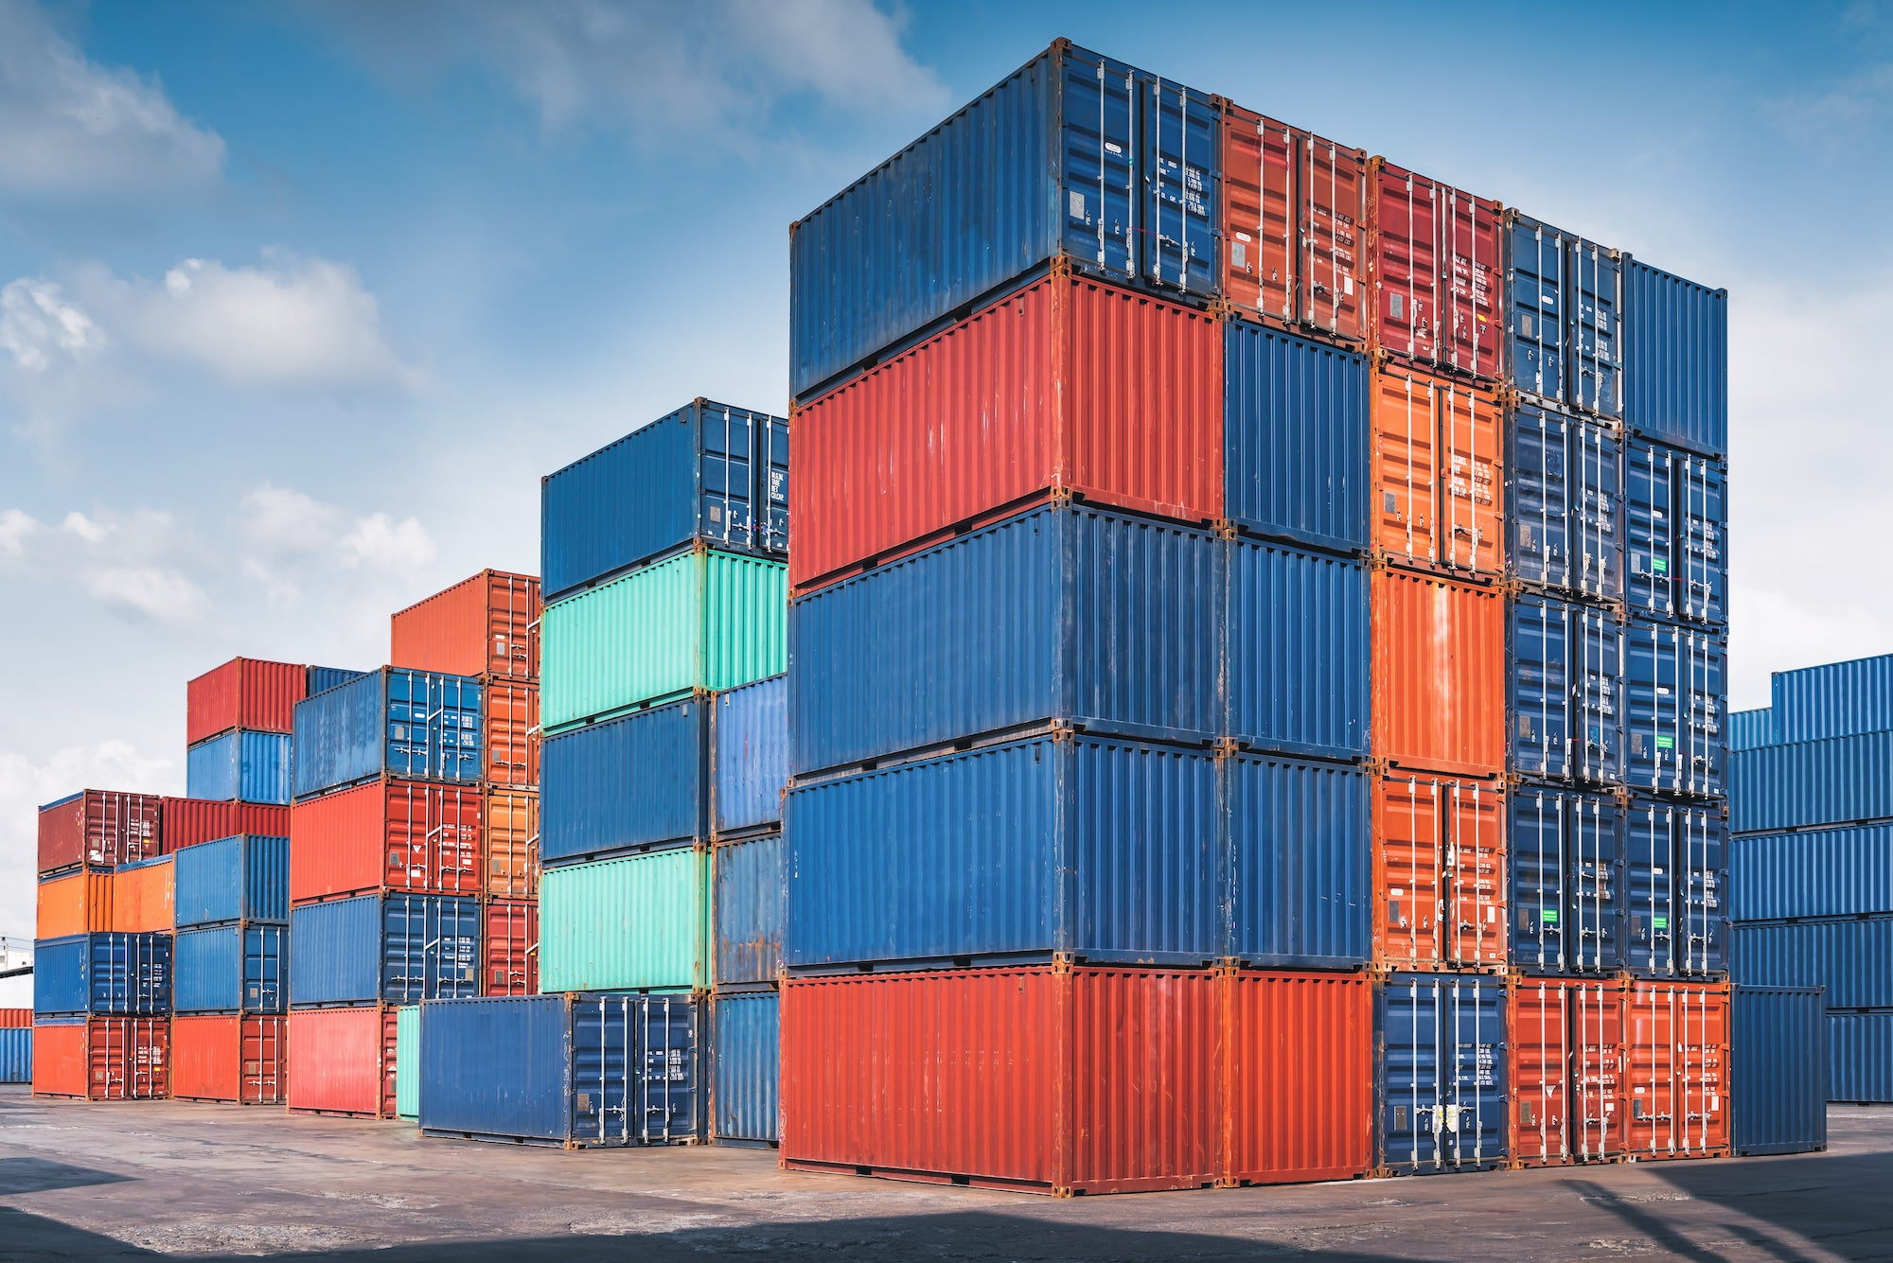
CONTAINERIZATION is a software deployment option that involves packaging up software code and its dependencies so it is easier to deploy across computing environments. A container is basically an Operating System (OS)-level virtualization method for deploying and running applications without launching an entire VM (virtual machine) for each application.
Prepared by: Jeremiah Gatong

Slide 2
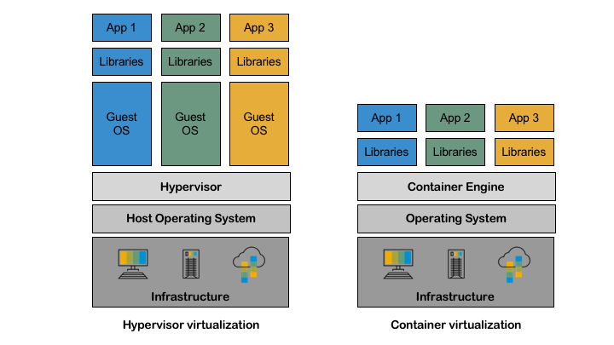
Containerization vs Virtualization
Containerization:
Uses the host operating system's kernel directly, lightweight, high portability
Examples include Docker, containerd, and rkt.
Virtualization:
Uses hypervisors, higher overhead due, less portable
Examples include VMware, Microsoft Hyper-V, and Oracle VirtualBox.

Slide 3
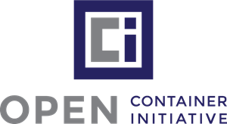
OCI
The primary goal of the OCI is to create open standards for container formats and runtime specifications to ensure interoperability and prevent vendor lock-in, OCI focus on:
Runtime Specification (runtime-spec): This defines the configuration, execution environment, and lifecycle of a container. A reference implementation of this specification is provided by runc, which is a lightweight, portable container runtime.
Image Specification (image-spec): This defines the format of a container image, which includes the content and metadata of the container. It ensures that container images can be consistently built, packaged, and distributed across different toolchains and platforms.

Slide 4
container Runtime
software responsible for running containers. Containers are a technology that packages an application and its runtime dependencies together in a consistent environment, which ensures that the application behaves the same regardless of where the container is run, below are its responsibility:
Image Management: Pulling, pushing, and managing container images from and to container registries.
Instantiation: Creating a running instance of a container from a container image.
Isolation: Ensuring that each container runs in its own namespace, limiting its impact on other containers and the host system.
Resource Management: Allocating system resources (CPU, memory, I/O) to containers and ensuring that they don't exceed their limits.
Networking: Providing network interfaces and connectivity to containers, often with isolated network namespaces.
Storage: Managing volumes and persistent storage for container data.
Security: Providing mechanisms for securing containers, such as user namespaces, seccomp profiles, cgroups, and more.
Lifecycle Management: Handling start, stop, restart, and deletion of containers.

Slide 5

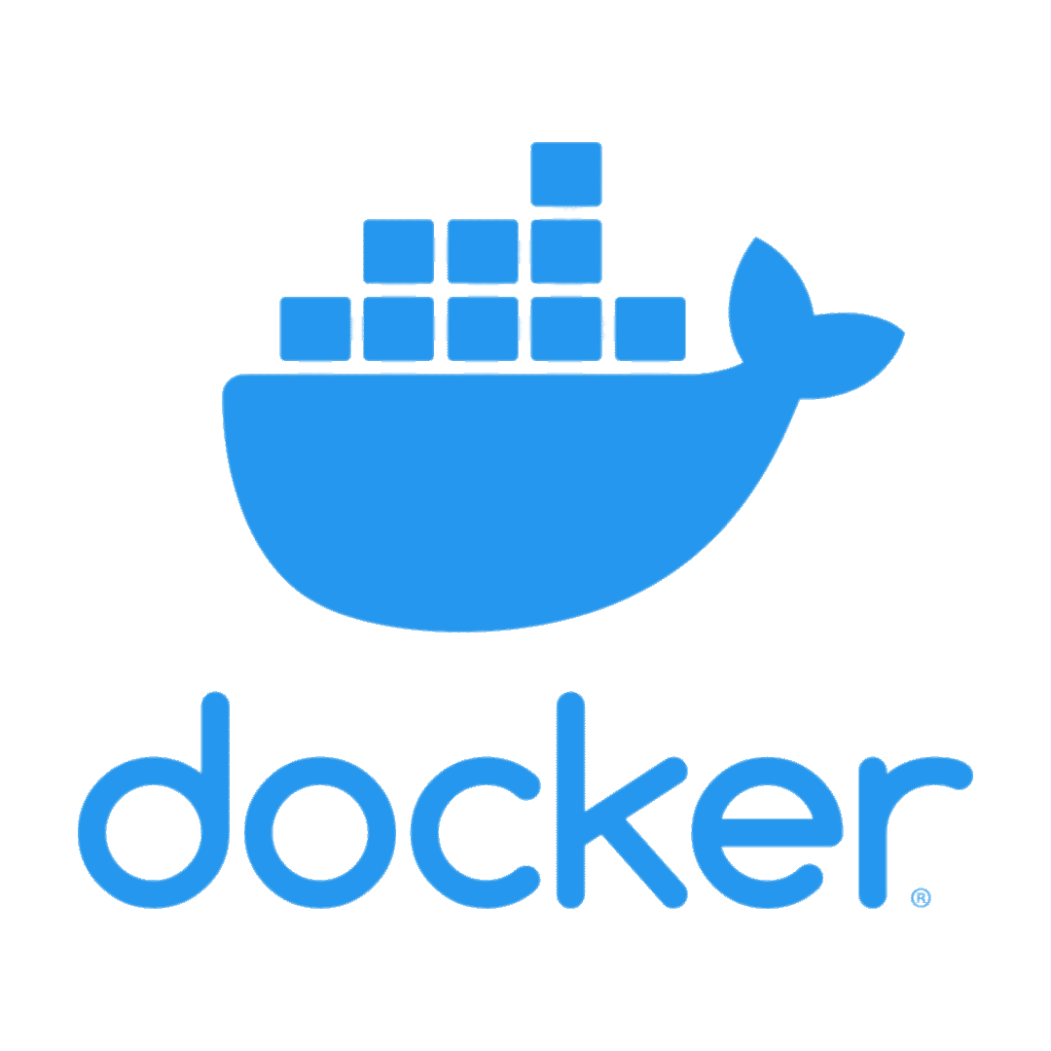


Popular container runtimes
runc: A lightweight, CLI-based container runtime that serves as the reference implementation for the Open Container Initiative (OCI) specification.
containerd: An industry-standard core container runtime. It provides the basic functionalities required for running containers and is used by Docker and Kubernetes.
Docker: While Docker is often thought of as just a container platform, its engine actually wraps around container runtimes (initially its own, then later runc) to manage the entire container lifecycle.
cri-o: A lightweight container runtime specifically for Kubernetes, implementing the Kubernetes Container Runtime Interface (CRI).
podman: is a tool for managing containers and images, volumes mounted into those containers, and pods made from groups of containers

Slide 6
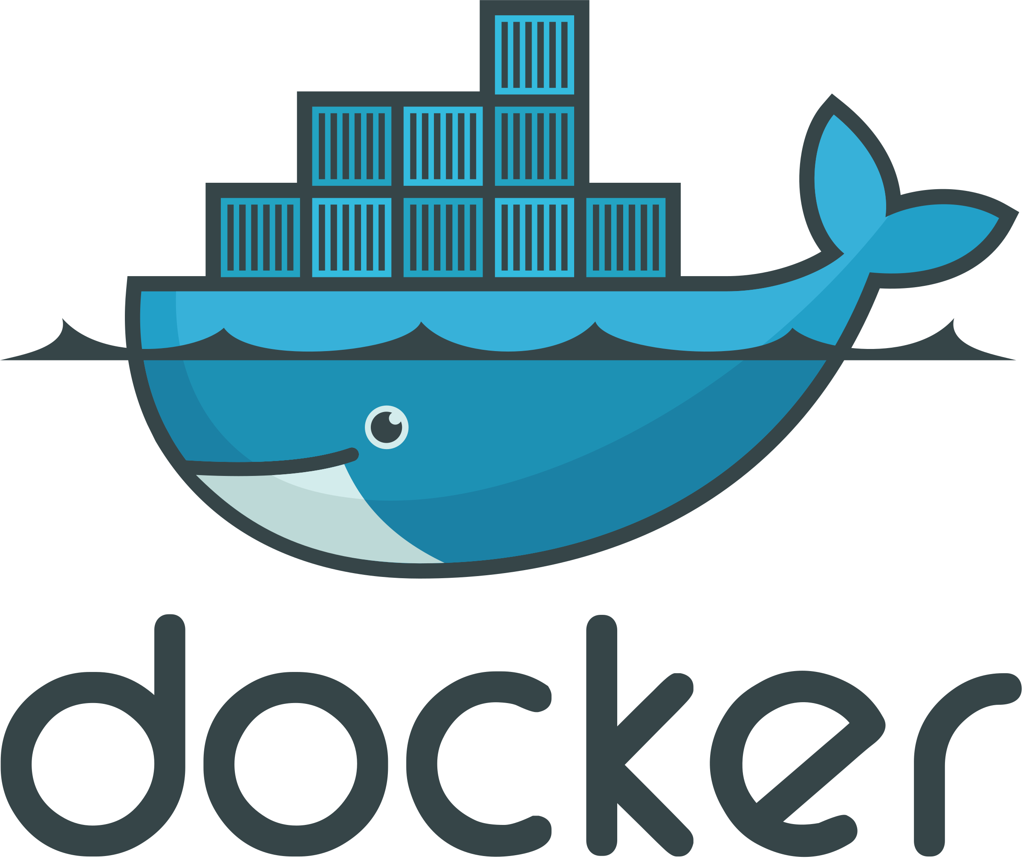
Docker
is a platform designed to develop, ship, and run applications inside containers. Containers are lightweight, stand-alone, and executable software packages that include everything needed to run a piece of software, including the code, runtime, system tools, libraries, and settings.
Docker Engine: The core component of Docker, responsible for building and running containers. It's a client-server application with a server (a long-running daemon process), a REST API specifying interfaces for interacting with the daemon, and a command-line interface (CLI) client.
Docker Image: A lightweight, stand-alone, and executable software package that includes everything needed to run a piece of software. Images serve as a blueprint for containers.
Docker Container: A runtime instance of a Docker image. It encapsulates the application and its dependencies.
Docker Hub: A cloud-based registry service where users and partners can publish and exchange container images.
Dockerfile: A script containing a series of instructions to create a Docker image.
Docker Compose: A tool for defining and running multi-container Docker applications. With Compose, you use a docker-compose.yml file to configure your application's services.

Slide 7
Dockerfile instructions
FROM: This instruction initializes a new build stage and sets the base image for subsequent instructions. Every valid Dockerfile must start with a FROM instruction.
MAINTAINER: Specifies the author of the Docker image. This instruction is now deprecated in favor of using labels.
RUN: Executes any command in a new layer on top of the current image and commits the result.
CMD: Provides defaults for an executing container. There can be only one CMD in a Dockerfile. If you specify more than one CMD, only the last CMD will take effect.
ENTRYPOINT: Allows you to configure a container that will run as an executable. Both CMD and ENTRYPOINT can coexist in a Dockerfile, but if the ENTRYPOINT is defined, the CMD value will be used as an argument for ENTRYPOINT.
COPY: Copies new files or directories from <src> and adds them to the filesystem of the container at the path <dest>.
WORKDIR: Sets the working directory for the RUN, CMD, ENTRYPOINT, COPY, and ADD instructions that follow it.
ENV: Sets environment variables.
EXPOSE: Informs Docker that the container listens on the specified network ports at runtime.
VOLUME: Creates a mount point with the specified name and marks it as holding externally mounted volumes from the native host or other containers.
LABEL: Adds metadata to an image.
USER: Sets the user name or UID to use when running the image and for any RUN, CMD, and ENTRYPOINT instructions that follow it.
ARG: Defines a variable that users can pass at build time to the builder with the docker build command.

Slide 8
Docker commands
docker run [image]: Create and start a container from an image.
docker start [container_id]: Start an existing container.
docker stop [container_id]: Stop a running container.
docker ps: List running containers.
docker logs [container_id]: Fetch the logs of a container.
docker exec -it [container_id] [command]: Execute a command in a running container.
docker stats [container_id]: Display live performance data for a container.
docker images: List all images.
docker rmi [image_id]: Remove an image.
docker build -t [tag_name] [path]: Build an image from a Dockerfile.
docker pull [image_name]: Download an image or a repository from a registry.
docker push [image_name]: Push an image or a repository to a registry.

Slide 9
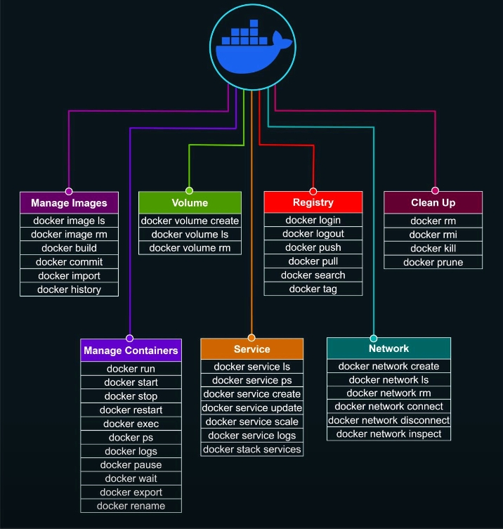

Slide 10
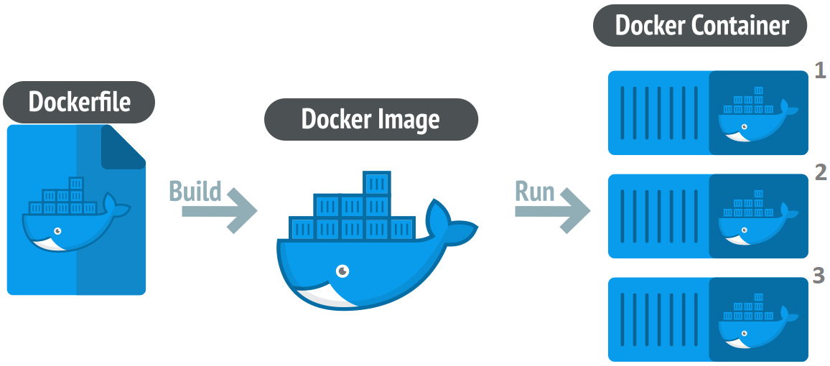

Slide 11
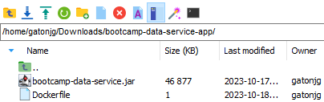
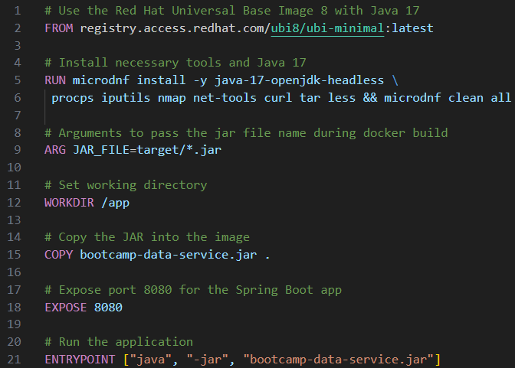

Slide 12
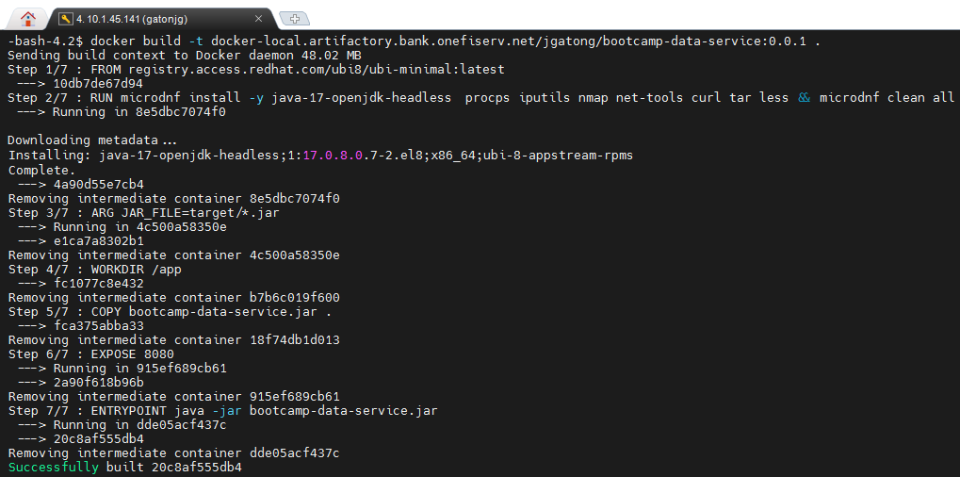

Slide 13
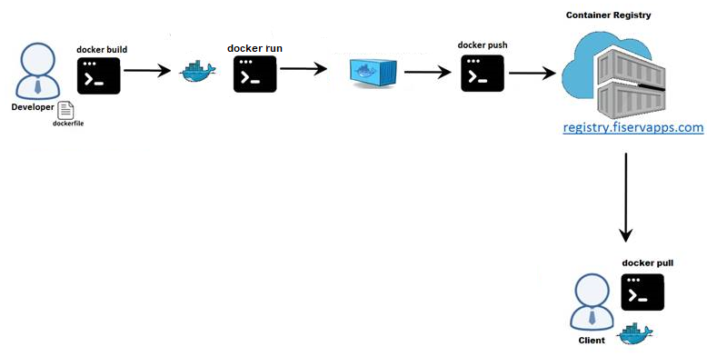
Delivery

Slide 14
DEMO

